Slide 1


How to make the Alma repository available via OAI
Yoel Kortick. Senior Librarian
https://www.wisegeek.com/what-are-online-surveys.htm
https://images.wisegeek.com/woman-looking-over-shoulder-at-computer.jpg

Slide 2






Contents
Introduction
The integration profile
The set
The general publishing profile
The repository is available via OAI
Payment status imported from Finance System invoice closed

Slide 3
Introduction
It is possible to make the contents of the Alma repository available via OAI-PMH, the Open Archives Initiative Protocol for Metadata Harvesting.
This is done by using an OAI integration profile and creating a set in Alma, then publishing it via the OAI protocol
For additional information see also https://developers.exlibrisgroup.com/alma/integrations/oai

Slide 4
Contents
Introduction
The integration profile
The set
The general publishing profile
The repository is available via OAI
Payment status imported from Finance System invoice closed

Slide 5
The integration profile
An integration profile of type ‘OAI Repository Definition’ should be created. See https://knowledge.exlibrisgroup.com/Alma/Product_Documentation/010Alma_Online_Help_(English)/090Integrations_with_External_Systems/030Resource_Management/060Setting_Up_OAI_Integration for more about this type of integration profile.
Via this integration profile the Alma can expose the records as OAI types and harvest them accordingly.
The integration profile is created via “External systems > Integration Profiles” under the General Configuration menu.

Slide 6
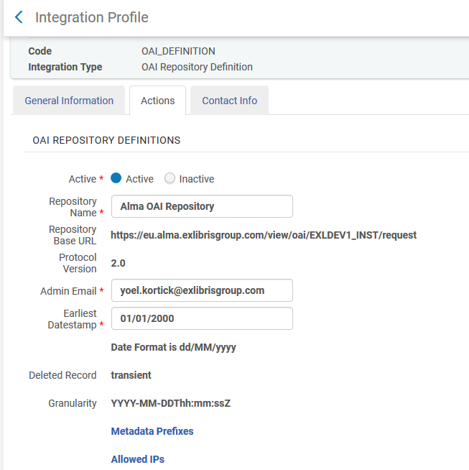
The integration profile
Here in the “Actions” tab the repository name and other technical information is chosen.

Slide 7
Contents
Introduction
The integration profile
The set
The general publishing profile
The repository is available via OAI
Payment status imported from Finance System invoice closed

Slide 8
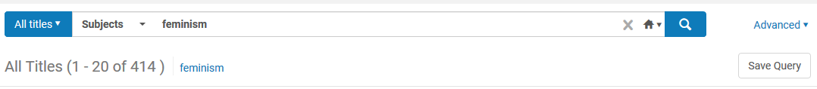
The set
In our case we will make a set of all records with word from subject “feminism”

Slide 9
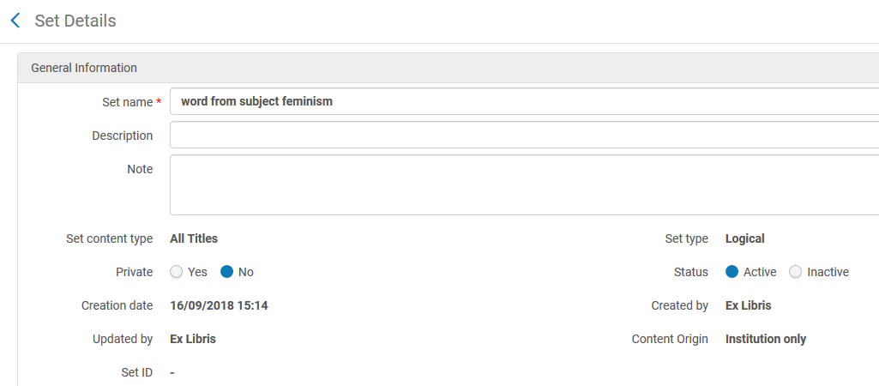
The set
We create the set

Slide 10
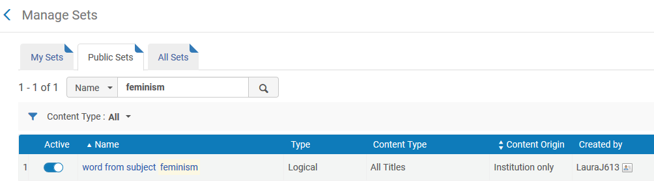
The set
The set is created

Slide 11
Contents
Introduction
The integration profile
The set
The general publishing profile
The repository is available via OAI
Payment status imported from Finance System invoice closed

Slide 12
The general publishing profile
We will focus here in the part of the general publishing profile relevant to OAI.
For full details on the general publishing profile see https://knowledge.exlibrisgroup.com/Alma/Product_Documentation/010Alma_Online_Help_(English)/090Integrations_with_External_Systems/030Resource_Management/080Publishing_and_Inventory_Enrichment

Slide 13
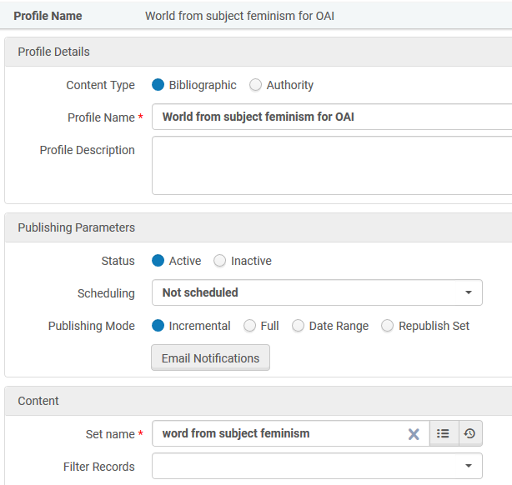
The general publishing profile
The publishing profile is called “Word from subject feminism for OAI” and uses the set we previously made called “word from subject feminism”

Slide 14
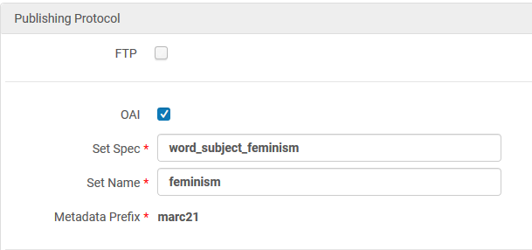
The general publishing profile
Define the publishing protocol as OAI and enter the desired set spec and set name.

Slide 15
The general publishing profile
The publishing profile is run

Slide 16
Contents
Introduction
The integration profile
The set
The general publishing profile
The repository is available via OAI
Payment status imported from Finance System invoice closed

Slide 17
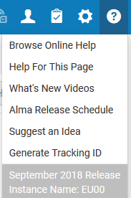
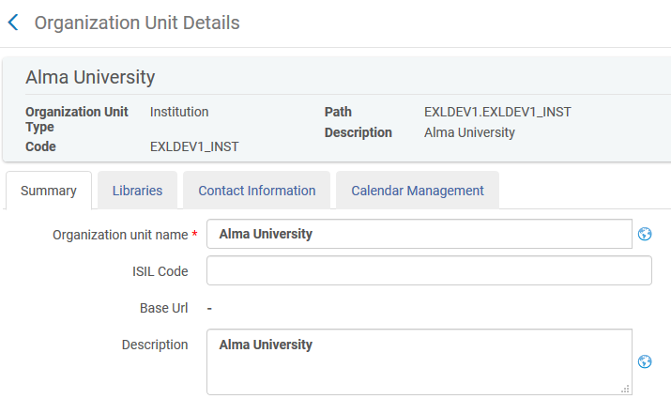
The repository is available via OAI
First confirm that OAI is set up properly
https://eu00.alma.exlibrisgroup.com/view/oai/EXLDEV1_INST/request?verb=Identify

Slide 18
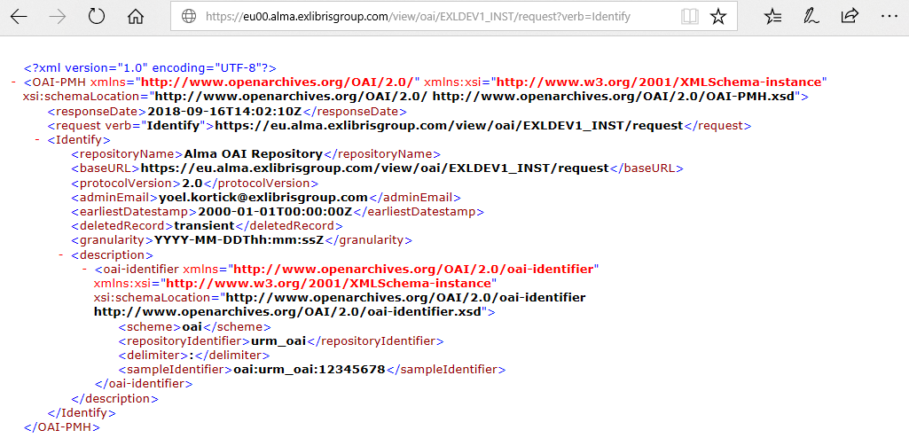
The repository is available via OAI
First confirm that OAI is set up properly

Slide 19
The repository is available via OAI
Confirm that the OAI set exists
https://eu00.alma.exlibrisgroup.com/view/oai/EXLDEV1_INST/request?verb=ListSets

Slide 20
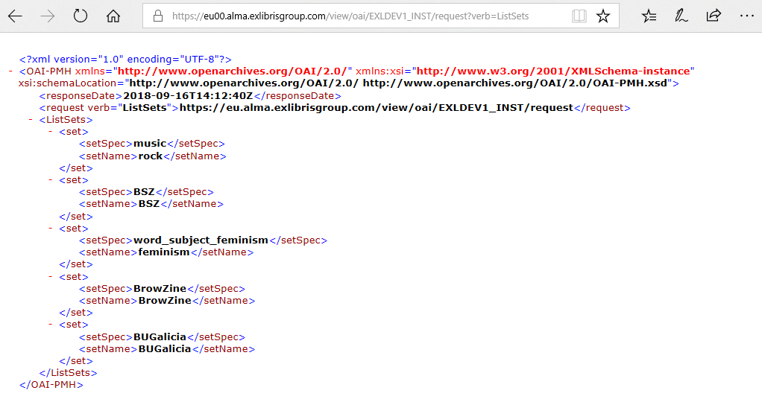
The repository is available via OAI
Confirm that the OAI set exists

Slide 21
The repository is available via OAI
See what metadata formats are available
https://eu00.alma.exlibrisgroup.com/view/oai/EXLDEV1_INST/request?verb=ListMetadataFormats

Slide 22
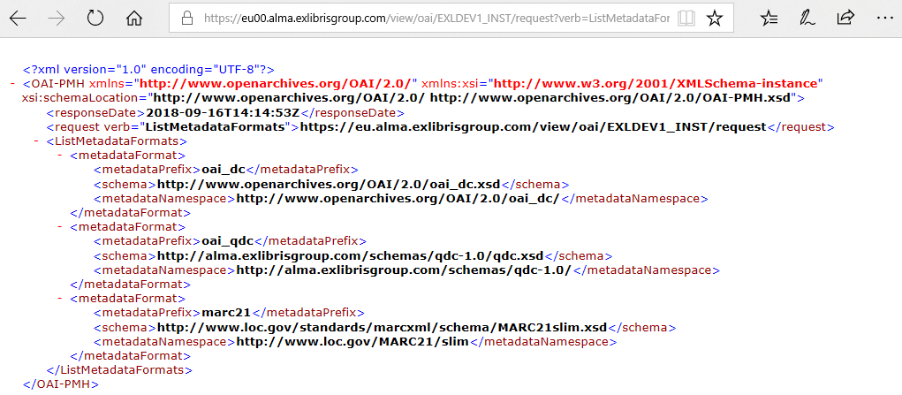
The repository is available via OAI
See what metadata formats are available

Slide 23
The repository is available via OAI
List identifiers for the set “word_subject_feminism” in MARC21
https://eu00.alma.exlibrisgroup.com/view/oai/EXLDEV1_INST/request?verb=ListIdentifiers&metadataPrefix=marc21&set=word_subject_feminism

Slide 24
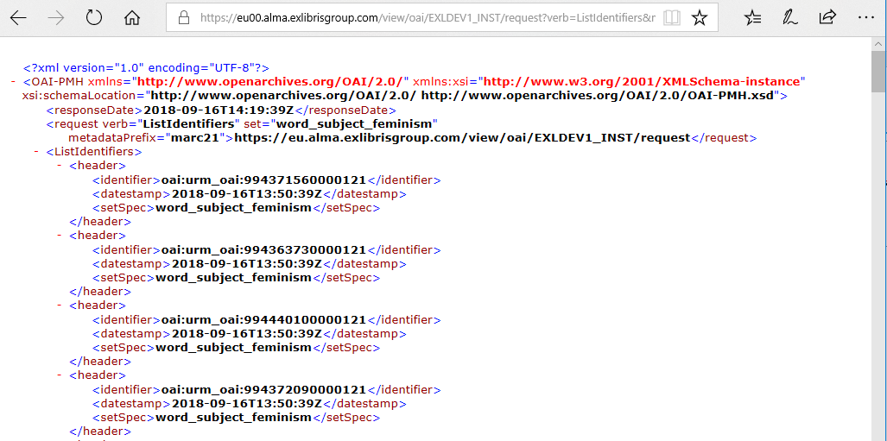
The repository is available via OAI
List identifiers for the set “word_subject_feminism” in MARC21
We will retrieve record with this identifier in next example

Slide 25
The repository is available via OAI
Get Specific Record according to identifier and metadata prefix
https://eu00.alma.exlibrisgroup.com/view/oai/EXLDEV1_INST/request?verb=GetRecord&identifier=oai:urm_oai:994371560000121&metadataPrefix=marc21

Slide 26
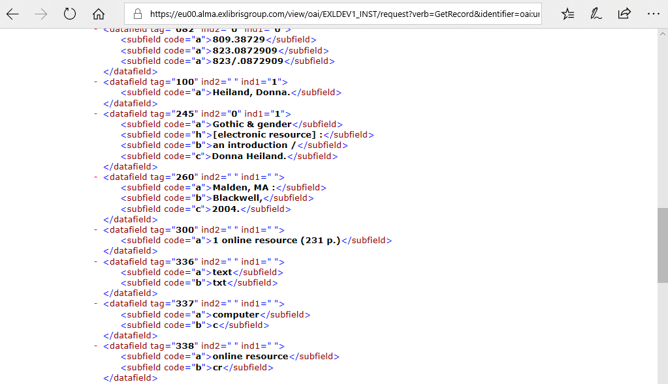
The repository is available via OAI
Get Specific Record according to identifier and metadata prefix

Slide 27
The repository is available via OAI
List Records without Date Range for the set “word_subject_feminism” in MARC21
https://eu00.alma.exlibrisgroup.com/view/oai/EXLDEV1_INST/request?verb=ListRecords&metadataPrefix=marc21&set=word_subject_feminism

Slide 28
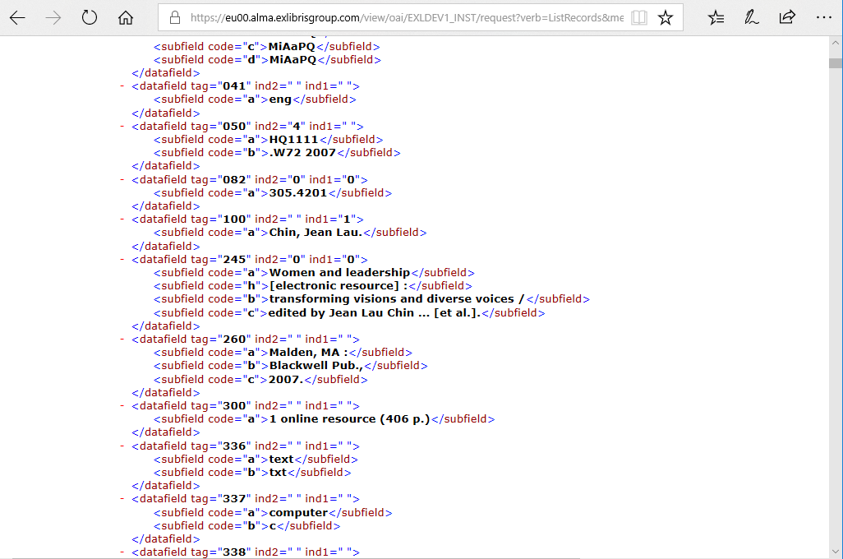
The repository is available via OAI
List Records without Date Range for the set “word_subject_feminism” in MARC21

Slide 29
The repository is available via OAI
List Records with Date Range for the set “word_subject_feminism” in MARC21
https://eu00.alma.exlibrisgroup.com/view/oai/EXLDEV1_INST/request?verb=ListRecords&metadataPrefix=marc21&set=word_subject_feminism&from=2018-01-015T03:06:13Z&until=2018-12-315T03:06:13Z

Slide 30
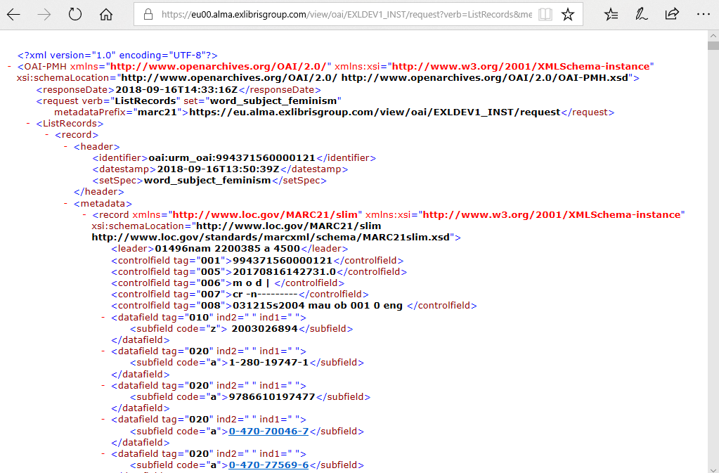
The repository is available via OAI
List Records with Date Range for the set “word_subject_feminism” in MARC21

Slide 31
Contents
Introduction
The integration profile
The set
The general publishing profile
The repository is available via OAI
OAI Syntax Examples

Slide 32
OAI Syntax Examples
See “OAI Syntax Examples” at https://knowledge.exlibrisgroup.com/@api/deki/files/50662/Misc_-_OAI_Syntax_examples.txt

